Slide 1
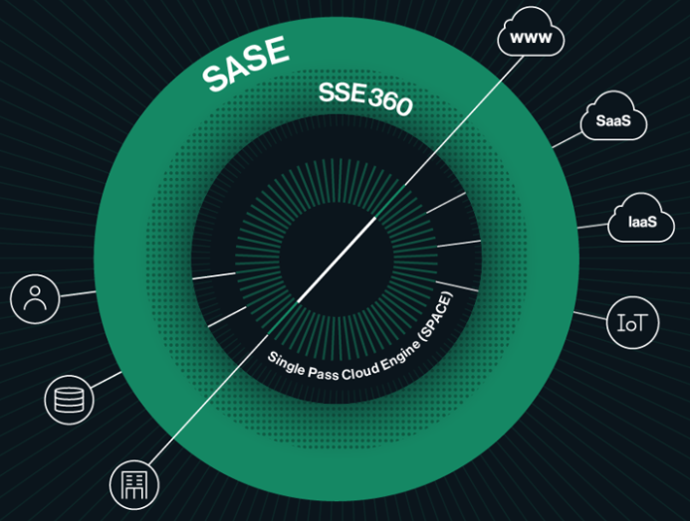
AI Security
Use Cases
Note – This deck is work in progress

Slide 2
AI Security – Use Case Demonstrations
Focus areas: AI for Users, AI for Applications and Agentic AI
AI for Users
AI for Applications
Agentic AI
Scenarios
Shadow AI Discovery Prompt Level Auditing
Protection Policies
Demo Focus
Visibility and Protection using Aim Browser Plugin Cato Client based Visibility & Protection
Outcomes
Discovery of AI Applications
Usage Reporting
Risk and Compliance Reporting
Scenarios
Homegrown App Inventory Coding Agent Discovery
Protection Policies
Demo Focus
Visibility and Protection using IDE Integration Hooks based Visibility & Protection
Outcomes
Discovery of Homegrown Applications
Tool Discovery
Scenarios
Agent Discovery Posture Management
Guardrails
Demo Focus
Visibility and Protection using APIs
Outcomes
Agent Observability
Runtime Controls

Slide 3
Additional Resources

